Slide 1
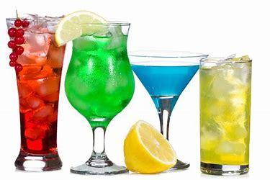
Student Alcohol Consumption

Slide 2
Target
The goal of the following work is to explore the relationship between alcohol consumption and academic performance of students in two secondary schools in Portugal
The final objective will be to predict the final Math grade through the use of ML methodologies and to provide advice to school management on how to improve each student's academic performance.

Slide 3
Timeline
Assegnazione workshop
17 sep
20 sep
27 sep
01 oct
EDA
Sviluppo
Risultati

Slide 4
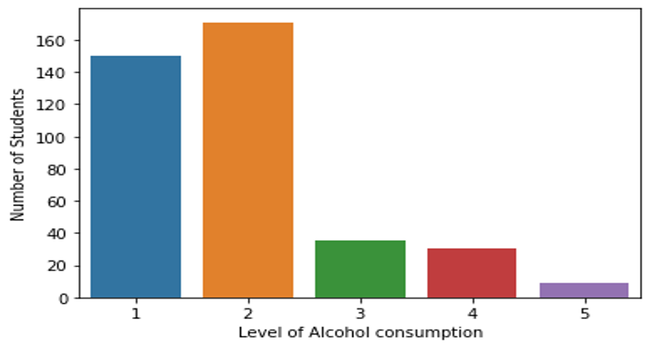
Dataset
395 students
MS and GP schools

Slide 5
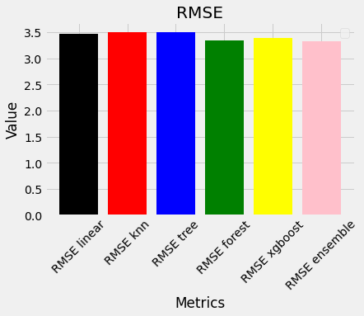
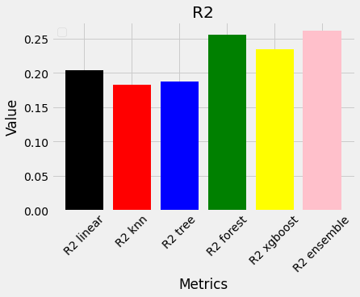
Model's comparison
The ensemble model of all ML trained models seems to provide the most accuracy in making predictions about academic performance

Slide 6
Kmeans Model
Kmeans is an unsupervised method of partioning n observations into k given clusters in which each observations belongs with the minor distance from cluster centroids

Slide 7
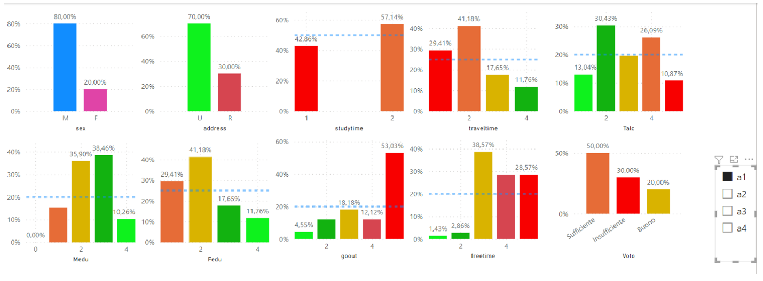
The boy from the suburbs
Male, high free time, low level parent's education

Slide 8
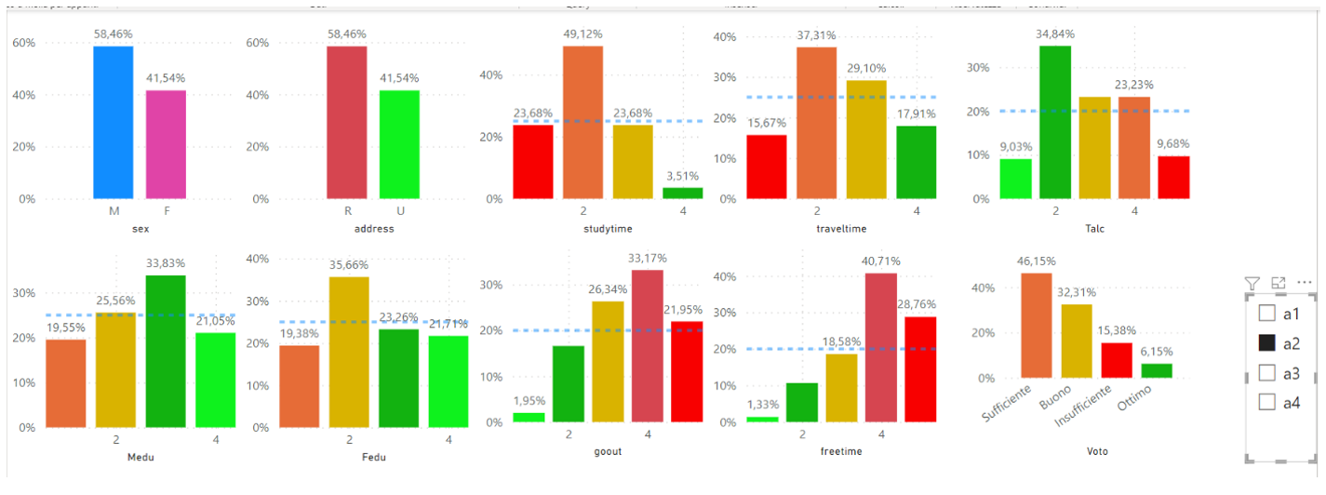
The average student
Average study time, average travel time, high freetime

Slide 9
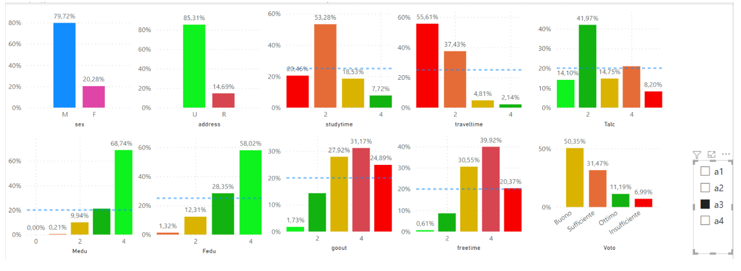
The good boy
Male, from town, high level parent's education, high free time

Slide 10
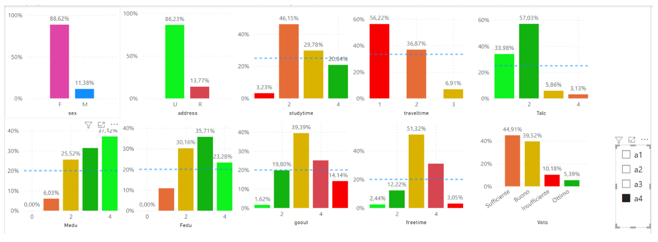
The good girl
Female, from town, high level parent's education, low level of alcohol consumption

Slide 11
Conclusion
With the provided dataset and the used ML methods it was found that while alcohol consumption is linked to low academic performance, it doesn't appear to be a cause but rather a consequence of other issues
If correctly and timely addressed at the root, the educator might be able to solve these issues and be a positive leading force for the student growth and development

Slide 12

Life is 10% what happens to you and 90% how you react to it Charles Swindoll

